Slide 1
Cross-Platform Applications
Using HTML 5 and PhoneGap
Notes:
Any mobile developers?
Anyone heard of PhoneGap before today?
Anyone currently using PhoneGap, or cross-platform frameworks?

Slide 2



Who AM I!?!
Justin Tindle
Consultant at KiZAN Technologies
Vertical Lead of Mobile/Windows 8 Development

Slide 3
Agenda
Single Platform vs. Cross-Platform
Hybrid Apps vs. Native Apps
What is PhoneGap?
Building Hybrid Apps with PhoneGap
Using PhoneGap Build
Using Icenium

Slide 4
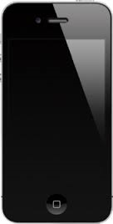
Single Platform
Development targets a single platform
Why?
Internal Apps
Highly controlled users
Streamlined App Development
Notes:
Most appropriate for internal apps
Highly controlled users on a standardized mobile platform
App development can be streamlined with reduced complexity designing, building, and testing apps.

Slide 5
Cross-Platform
Development targets multiple platforms
Why multiple platforms?
Fragmentation
BYOD (Bring Your Own Device) policy
General mobile market
Issues
More complex development processes
Notes:
Mobile platform fragmentation
BYOD (Bring Your Own Device) policy
Developing apps for the general mobile market
More complexity in designing, building, and testing applications across multiple platforms

Slide 6
Hybrid App
PROS
CONS
BEST FOR
Cross-platform apps
Developers new to mobile
Getting to market quickly
Notes:
Leverages the power of HTML, CSS, and JavaScript with access to native APIs
PhoneGap (Apache Cordova) can be utilized to create hybrid app containers
A build must be created for each platform
PROS
Familiar technologies
Access to many device APIs and sensors
Apps can be deployed and installed from an app store and be monetized
Mostly common code base
CONS
Performance
Think carefully about performance (older devices)
Cross browser issues
Must be aware of cross browser differences
Doesn’t look native
If you object is to make it feel native, re-implementation of native controls is difficult
BEST FOR
Cross-platform apps
Deploying to app store for monetization
Native code required for APIs not exposed by PhoneGap
Web Developer already and your project intends to target 2 platforms (PhoneGap will be more efficient)
Local database – native developers (call into native data storage libraries, core data), exposes those through API, LocalStorage, HTML File System API, JSON to text files to disk, load them from disk
Underscore LINQ for JavaScript

Slide 7
Native App
PROS
CONS
BEST FOR
Single platform apps
Graphic intensive games / Unique interfaces
Performance optimized apps
Notes:
Access to platform-specific SDKs and languages to build an app
PROS
Unrestricted access to platform
Maximum Performance
Only limits are the platform and your imagination
CONS
Most expensive, least flexible for cross-platform development
Native language and tools for each platform
Shortage of Developers
Low code reuse between platforms
BEST FOR
Single platform mobile app or an app’s requirements exceed the capabilities of Hybrid
Graphic intense games and unique interfaces
Performance optimized apps

Slide 8

What is PhoneGap?
Allows developers to package their web application as an App
Notes:
Allows developers to package their web application as an App
A common API for device functions and sensors across platforms
Shell – starts web browser control
Pages display in browser
Installed like every native app

Slide 9
PhoneGap PROS
Leverage existing development skills
A common code base and API across multiple platforms
Cheaper
Shorter time to market
Notes:
Leverage existing development skills with HTML, CSS, and JavaScript
A common code base across multiple platforms
Give you access to a common device API across multiple platforms (iOS, Android, Windows Phone, Blackberry)
Can create full featured cross-platform apps that behave and function like a native app at a much lower cost
PhoneGap Build Service allows you as a developer to build these apps in cloud without using native tools
Compare time to building same app across platforms natively

Slide 10
PhoneGap CONS
Limited access to device API/Sensors
May require native tools
PhoneGap Build
Icenium
Lower performance
Apps can be more easily rejected
Notes:
Doesn’t give you full access to a devices API and sensors (out of the box)
Can write your own plug-in or use someone else's
Doesn’t have access to same features across all platforms
Requires native tools unless using PhoneGap Build Service or Icenium
Icemium is currently limited to Android and iOS platforms
More complexity in designing, building, and testing the app across multiple platforms
Lower performance as compared to a natively optimized application
Apps may be rejected by app stores if they are too sluggish and don’t seem native

Slide 11
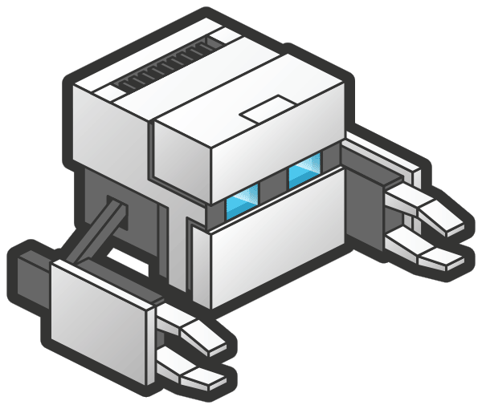
Building Hybrid Apps with PhoneGap
Pick your platforms
Create your web application using familiar web technologies
Package app in hybrid container for chosen platforms
Submit to store
????
Profit
Notes:
Inefficient to build a native app across platforms
Multiple languages and tools to learn
A free and open source framework that allows you to create mobile apps using standardized web APIs
Bridges the gap between the browser and device specific APIs and sensors
PhoneGap framework embeds HTML5 code inside a native WebView on the device using Foreign Function Interface to access the native resources of the device
Hybrid Container Ap

Slide 12
Pick Platforms
What questions should I be asking?
Chosen Platforms
iOS, Android, Windows Phone 8, Windows Store
Notes:
Market share

Slide 13
Create Web Application
Single Page Application
Tools
jQuery Mobile
User Interface
Knockout
MVVM Framework
PhoneGap
Access to device APIs
Notes:
All necessary code is loaded into a single page
Make it feel native: fast and fluid, it’s all about perception
Most obvious choice with a hybrid container app
All necessary code is loaded into a single page, or necessary code is loaded dynamically and added to page when needed.
Make it feel native: fast and fluid, it’s all about perception
Most obvious choice when pairing with a hybrid container app for the native feel
Go over take a picture, jquery mobile page (View), view model

Slide 14
Package
Create Hybrid Container Apps
iOS – Xcode
Android – Eclipse
Windows 8 / Windows Phone 8 – Visual Studio
Use a WebView to render your web application
Use PhoneGap to access the device
Alternative packaging
Use PhoneGap Build
Use Icenium
Notes:
Show Container Apps

Slide 15
PhoneGap Build
Creates app packages for you
6 platforms
Build from
github
ZIP file
Access to Mac is still necessary
For access to key chain
For loading app to store
Only Approved Plugins
Notes:
iOS
Android
Windows Phone
Blackberry
WebOS
Symbian
Show PhoneGap Build

Slide 16
Icenium
Use Icenium to develop, test, and publish
Only targets iOS and Android
Several options
Windows Client
Web Client
Visual Studio Extension
Eliminates need for Mac
Icenium ION
Allows ability to test on iOS without provisioning
Can publish directly from web client
Custom Plugins
Notes:
Show Icenium

Slide 17

iOS Demo

Slide 18

Android Demo

Slide 19
What did we discuss?
Single Platform vs. Cross-Platform
Hybrid vs. Native
What is PhoneGap?
Building Hybrid Apps with PhoneGap
Using PhoneGap Build
Using Icenium

Slide 20
Contact Information
Email
justin.tindle@kizan.com
GitHub
https://github.com/justintindle
Repo – mobilecincy-phonegap
Twitter
@justintindle
Questions?

